Slide 1

Apartment Management System
Group 14:
Haoran Li
Isham
Jiahao Shi
Xiyuan Jin
Taking care of your home so you don’t have to

Slide 2

Contents
Introduction
ERD
Server-Side Modules
Report and Analysis
Future Scope

Slide 3

Introduction

Slide 4
P U R P O S E
Maintain data generated by room-mates to help manage their apartment effectively and track other tasks concurrently.
Academic
Personal
/Common
Expenses
Daily Schedule

Slide 5
Benefits
Track essential information(Emergency Contacts, COVID test schedule/result) of flat mates for faster and easier access in time of need.
Track the personal and shared expenses of flat mate to provide insight into their finances.
Track the courses enrolled by flat mates for a better understanding of their academic state.
Track the grocery items bought by flat mates to estimate the inventory available in the kitchen pantry and to also know when the items should be used by.

Slide 6

ERD

Slide 7
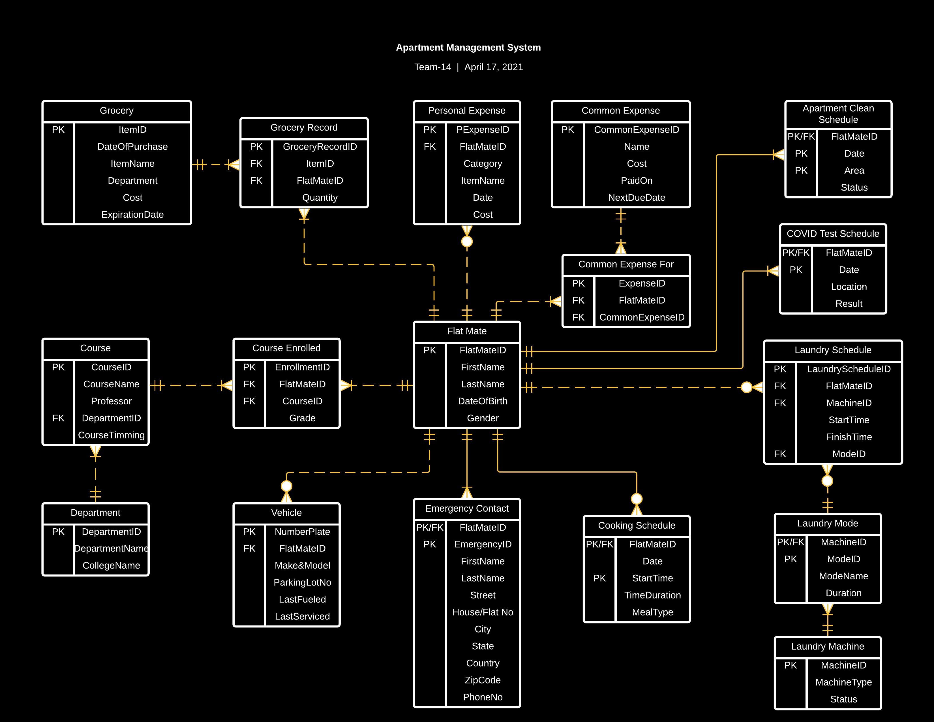
E
R
D

Slide 8
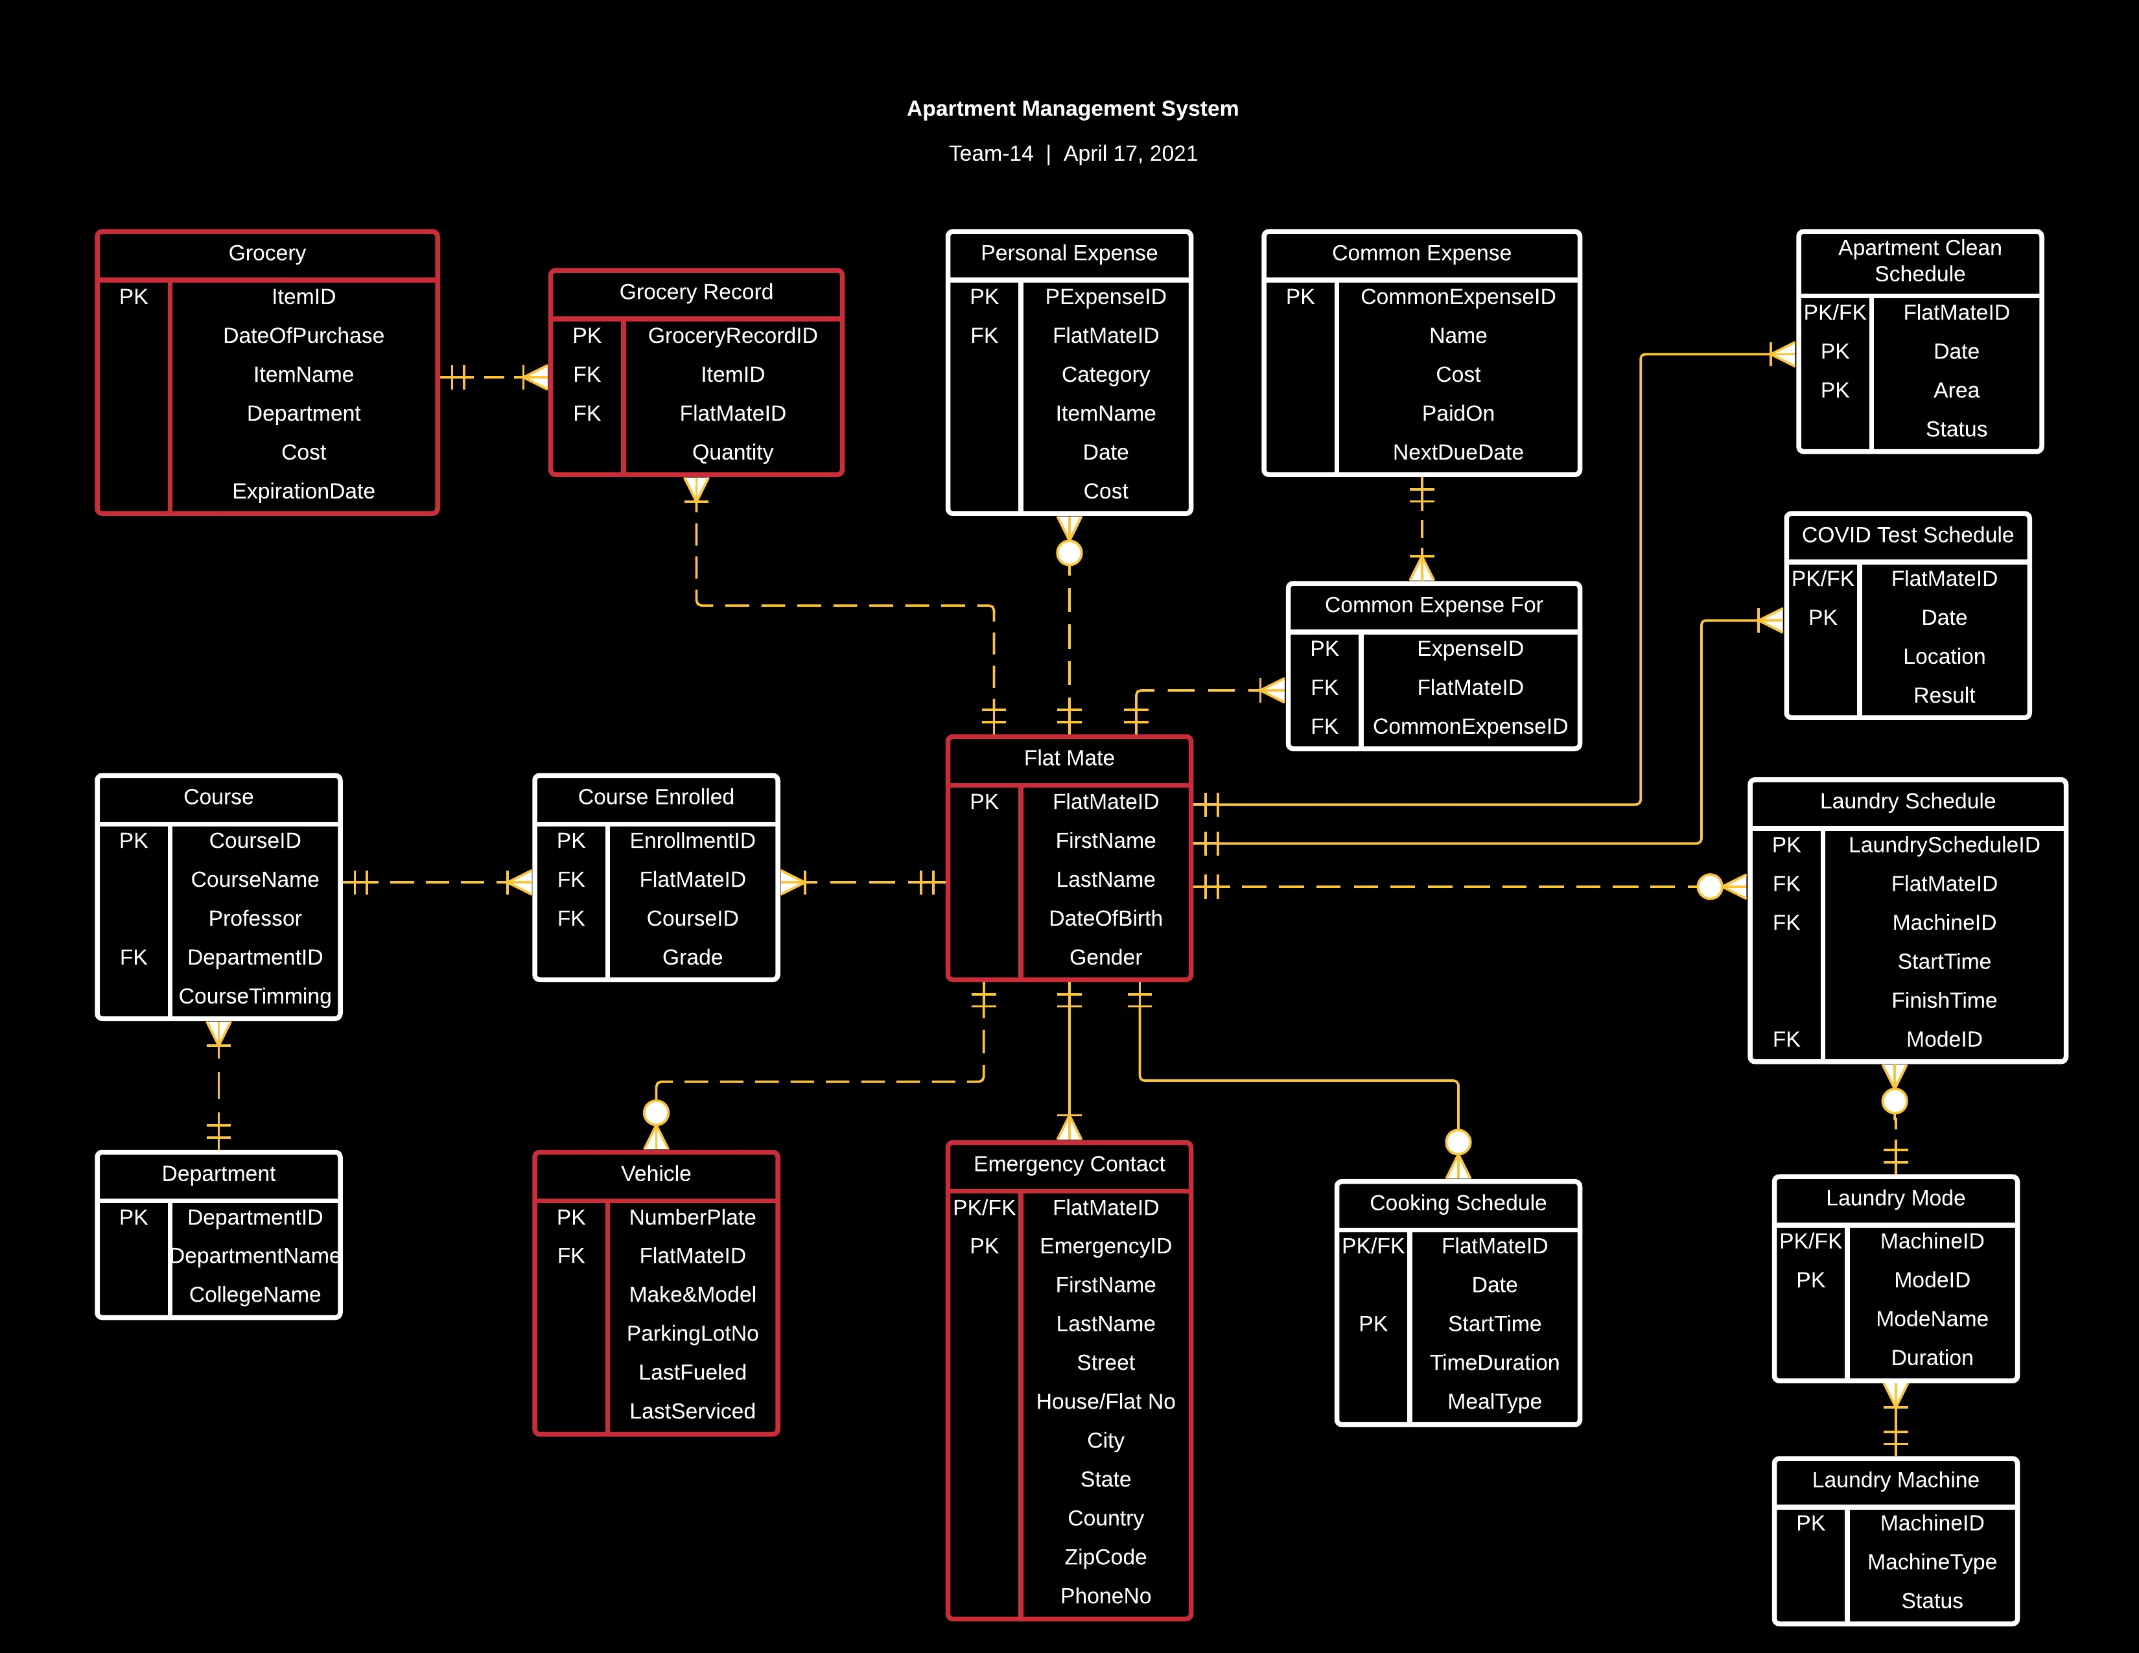
E
R
D

Slide 9
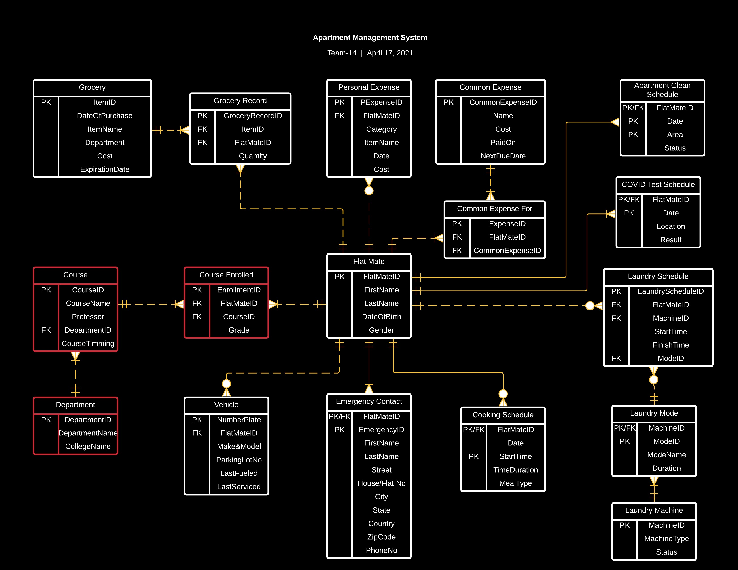
E
R
D

Slide 10
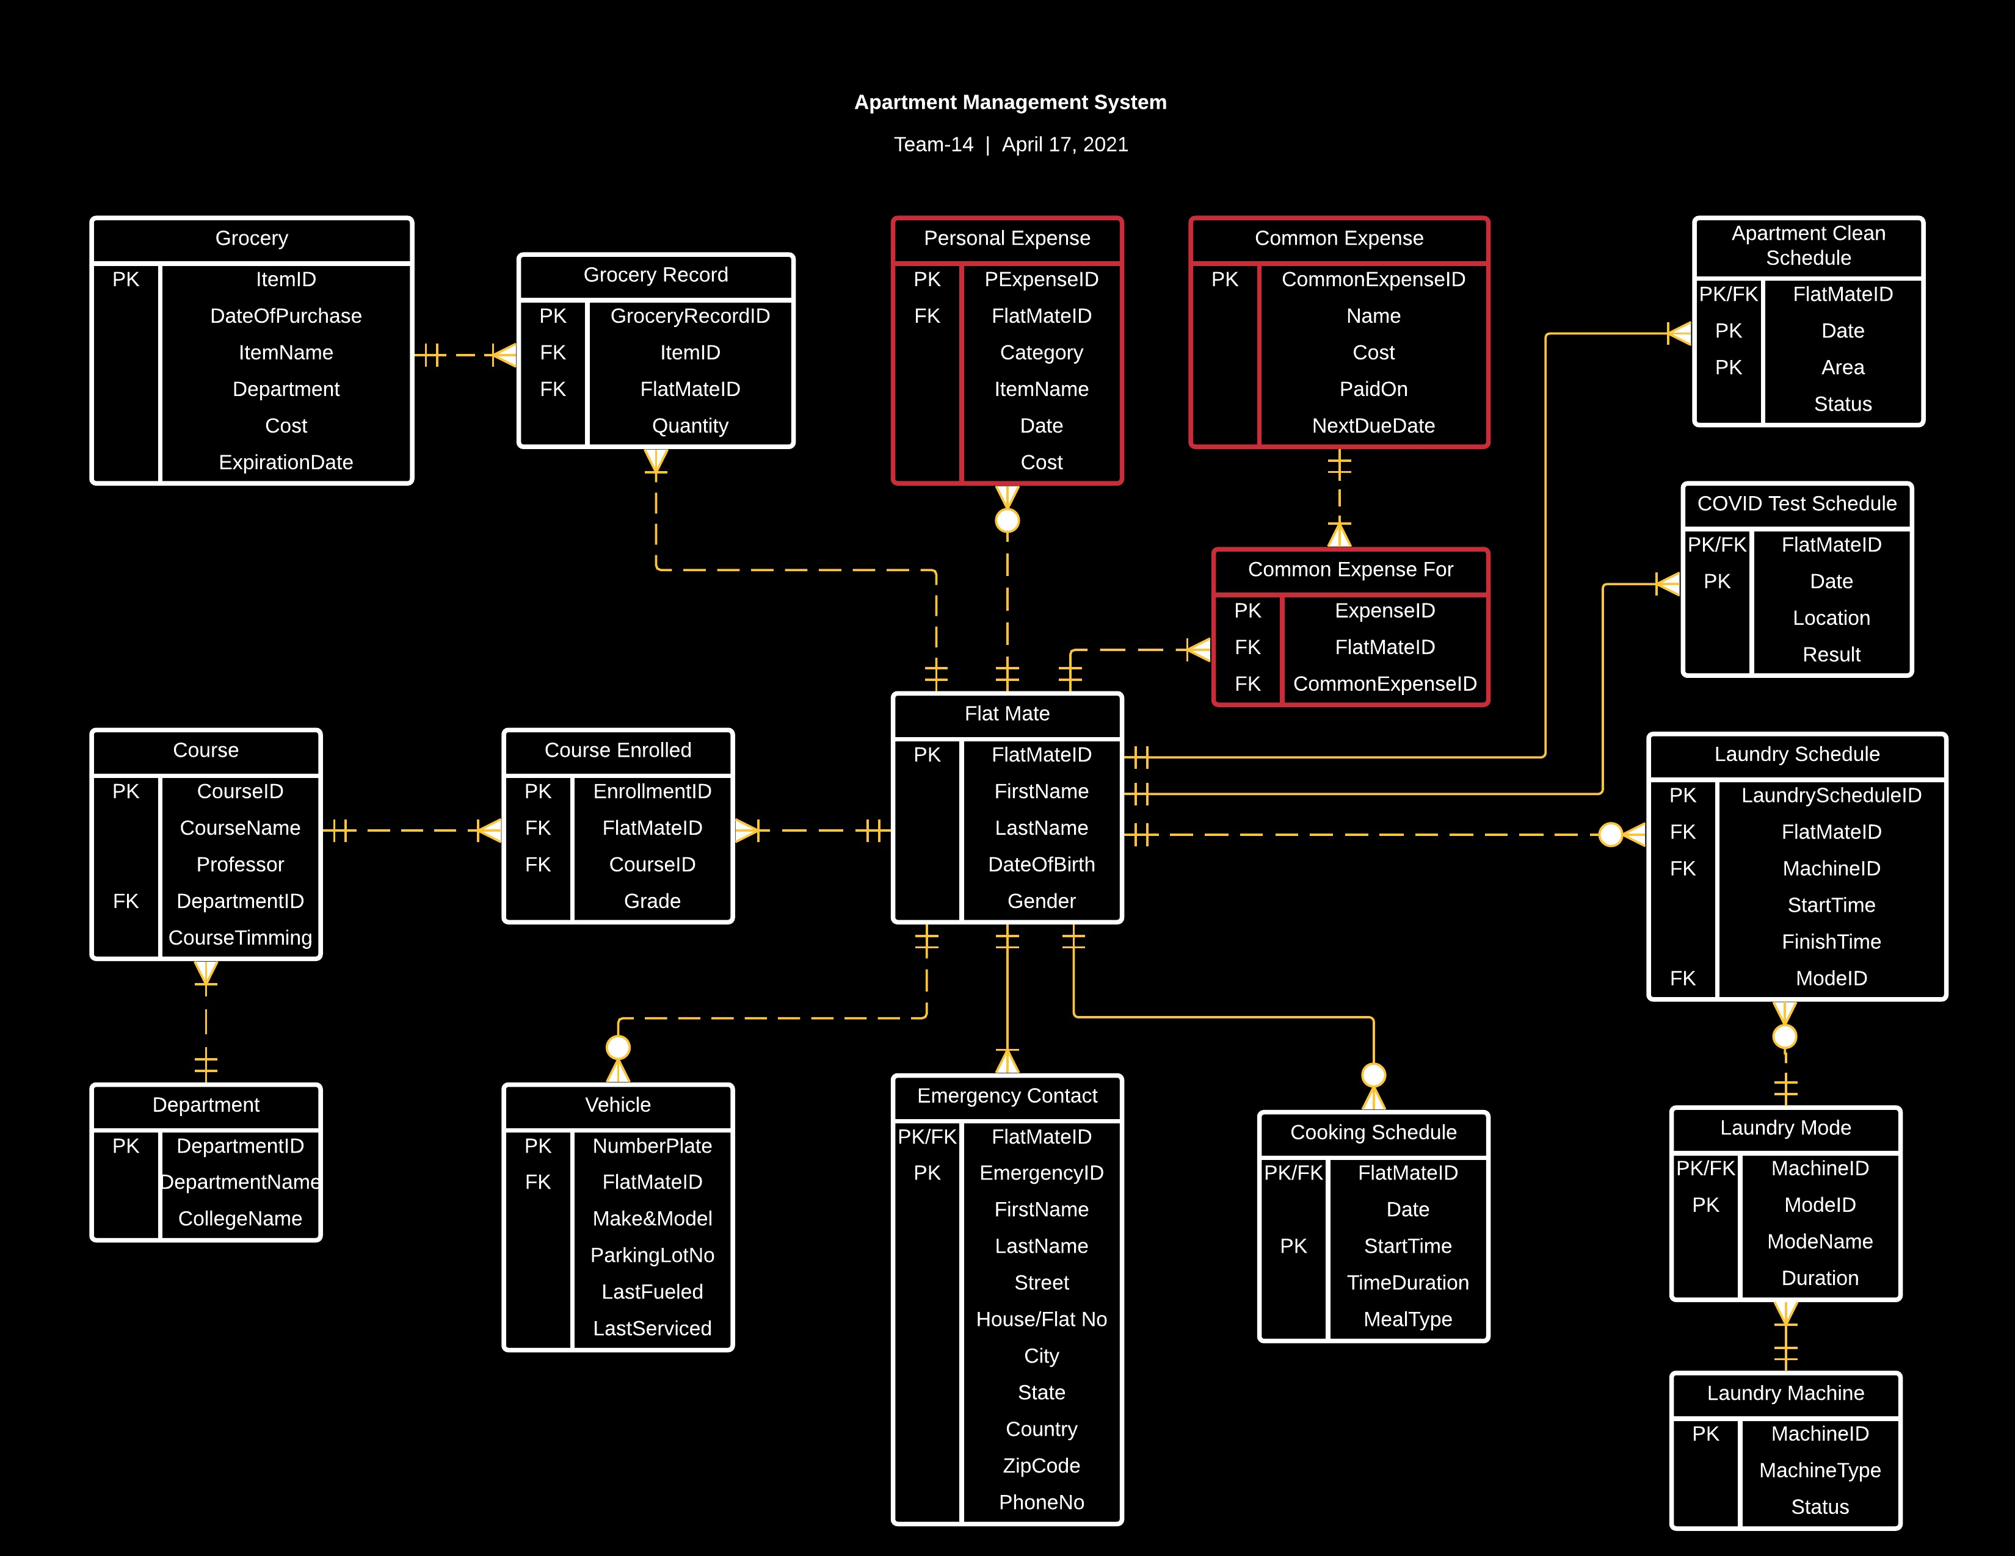
E
R
D

Slide 11
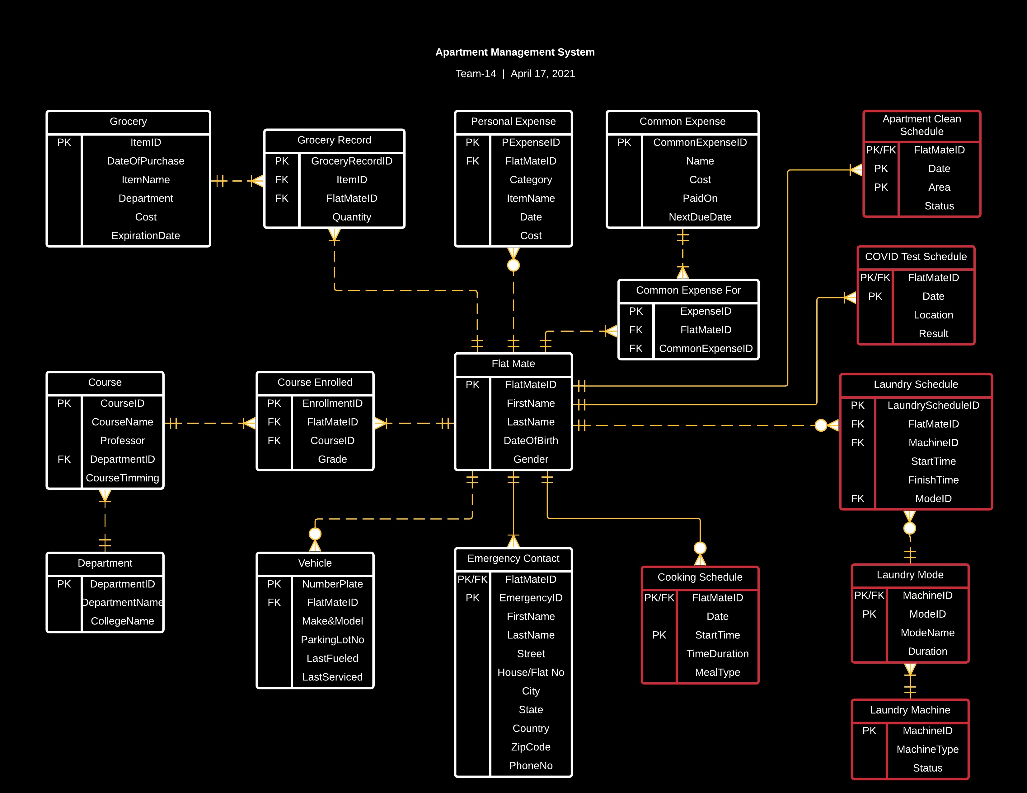
E
R
D

Slide 12

Server-Side Modules

Slide 13
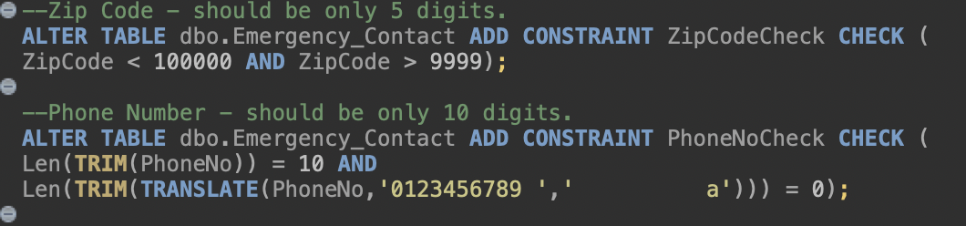
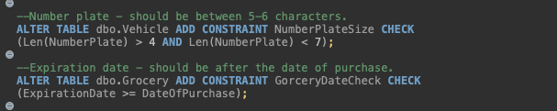
Check Constraints
Zip Code - should be only 5 digits.
Phone Number - should be only 10 digits.
Number plate - should be between 5-6 characters.
Expiration date - should be after the date of purchase.

Slide 14
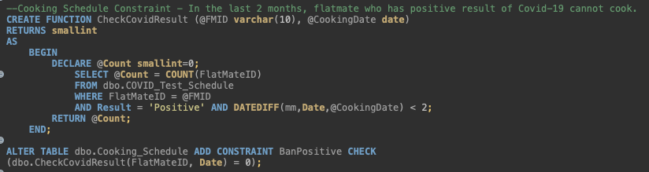
Check Constraints
Cooking Schedule Constraint - In the last 2 months, flat mate who has positive result of Covid-19 cannot cook.

Slide 15
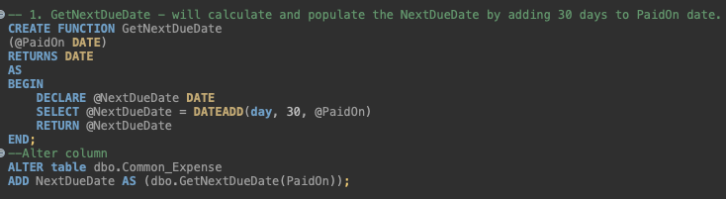
Computed Columns
GetNextDueDate – according to this rule, NextDueDate will be calculated and populated by adding 30 days to PaidOn date. This is done because common expenses such as electricity, utilities, etc. is paid only once a month.

Slide 16
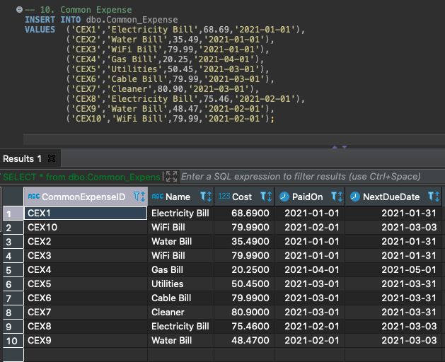

Computed Columns (Output)
Only PaidOn date is entered for the table. NextDueDate is calculated according to the function declared.

Slide 17
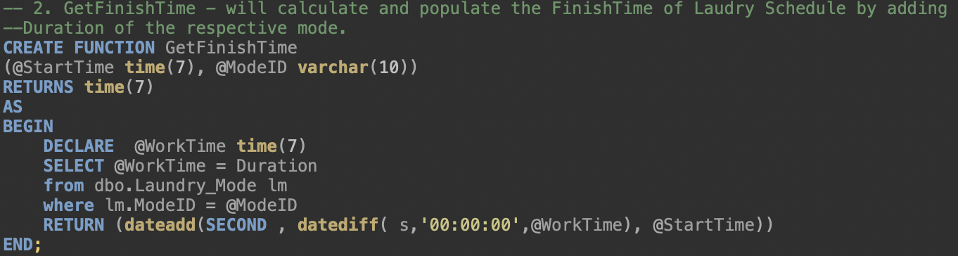
Computed Columns
GetFinishTime –according to this rule, machine Finish Time is calculated by getting the duration for the respective machine and then adding it to the Start Time.

Slide 18
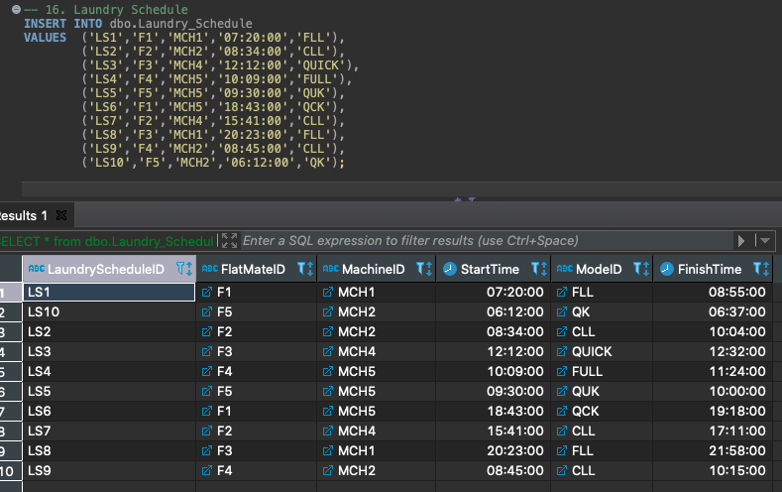
Computed Columns (Output)
Only StartTime is entered for the table. FinshTime is calculated according to the function declared.

Slide 19

Report & Analysis

Slide 20
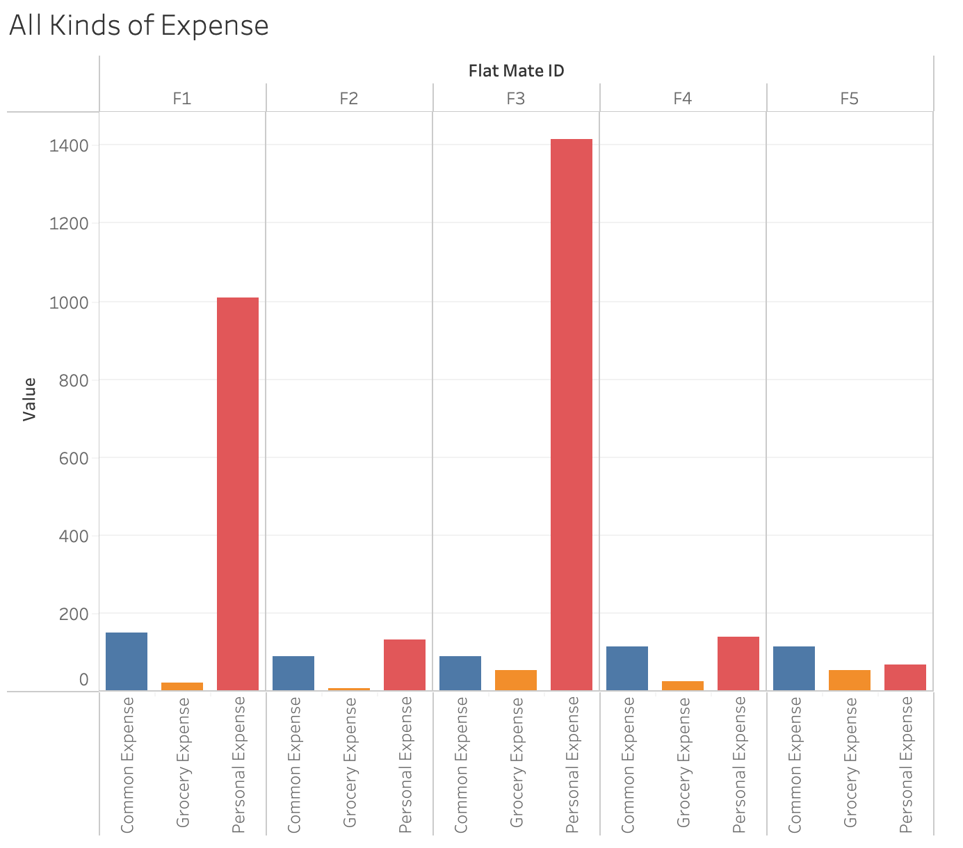
This chart is a breakdown of various expenditure pattern of all room mates.

Slide 21
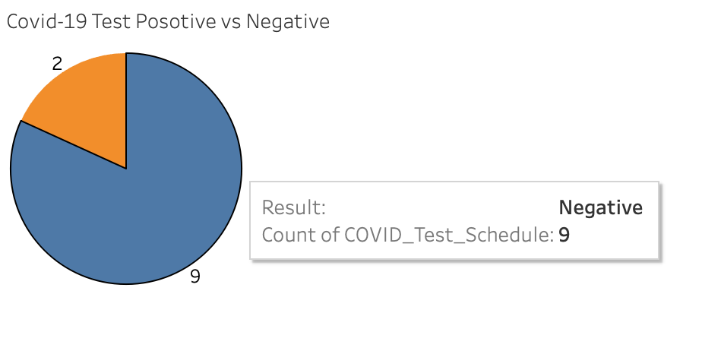
The pie chart depicts the pictorial representation of COVID test results for all the room mates.

Slide 22
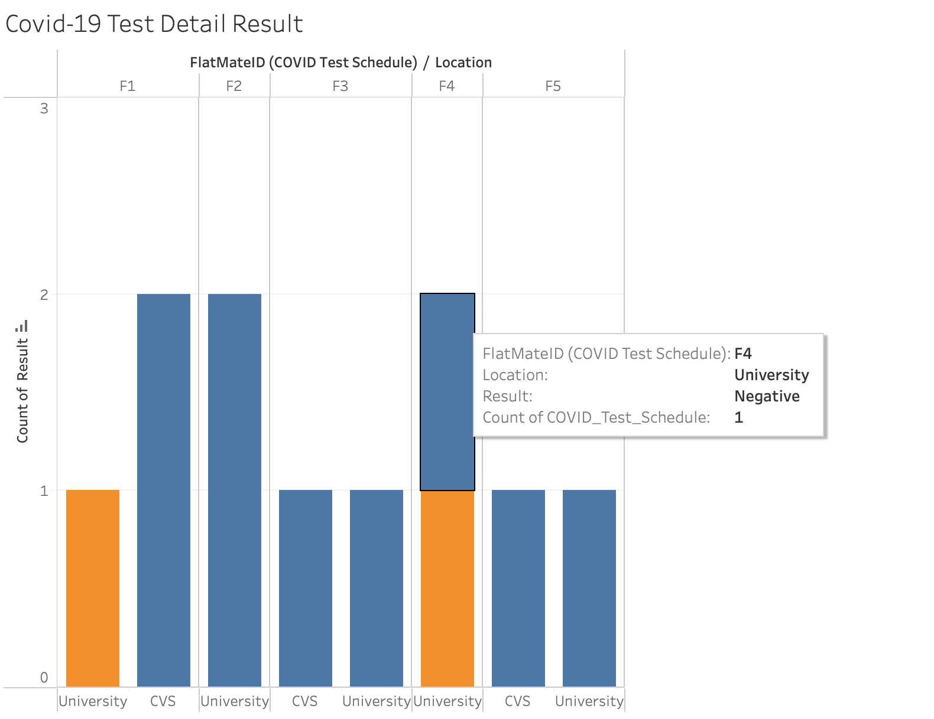
The bar graph represents the COVID test results of flat mates at different testing location.

Slide 23

Future Scope

Slide 24
Areas of Improvement
The current version of the database is only for a small group of people living in a single apartment. It can be scaled to store and process data for many people living in different apartments.
The database can have more descriptive data so that analysis can be done on an even smaller scale.
The database can be implemented alongside UI so that alert message can be sent to users (Expiration date, NextDueDate, FinishTime, etc.)

Slide 25
Thank You!
Credits: Prof. Simon & TA Team

Slide 26

Q & A

